Slide 1
Informed Search

Slide 2
Different approaches
Brute-Force Approach
Heuristic Search
Two-Player-Games Search
Interleaving Search

Slide 3
Game Playing
Why do AI researchers study game playing?
It’s a good reasoning problem, formal and nontrivial.
Direct comparison with humans and other computer
programs is easy.

Slide 4
Games vs. Search Problems
Unpredictable opponent → specifying a move for every possible opponent reply
Time limits → unlikely to find goal, must approximate

Slide 5
Game Playing Strategy
Maximize winning possibility assuming that opponent will try to minimize (Minimax Algorithm)
Ignore the unwanted portion of the search tree (Alpha Beta Pruning)
Evaluation(Utility) Function
  A measure of winning possibility of the player

Slide 6
Two-Player Game
Opponent’s Move
Generate New Position
Game
Over?
yes
no
Generate Successors
Evaluate Successors
Move to Highest-Valued Successor
no
Game
Over?
yes

Slide 7
MINMAX Algorithm
a kind of backtracking algorithm
is used in decision making and game theory to find the optimal move for a player,
is used in wo player turn-based games such as Tic-Tac-Toe, Backgammon, Mancala, Chess, etc.
assuming that
  The opponent is rational – will play to win.
  The game is zero-sum – if one player wins, the other loses.
  Usually, the two players have complete knowledge of the game. For games such as poker, this is clearly not true.
In Minimax the two players are called maximizer and minimizer. The maximizer tries to get the highest score possible while the minimizer tries to do the opposite and get the lowest score possible.
Every board state has a value associated with it. In a given state if the maximizer has upper hand then, the score of the board will tend to be some positive value. If the minimizer has the upper hand in that board state then it will tend to be some negative value. The values of the board are calculated by some heuristics which are unique for every type of game.

Slide 8
MINMAX Algorithm
the two players are called maximizer and minimizer.
  The maximizer tries to get the highest score possible
  the minimizer tries to do the opposite and get the lowest score possible
Strategy :
  Every board state has a value associated with it
  In a given state if the maximizer has upper hand then, the score of the board will tend to be some positive value
  If the minimizer has the upper hand in that board state then it will tend to be some negative value.
  values of the board are calculated by some heuristics which are unique for every type of game.

Slide 9
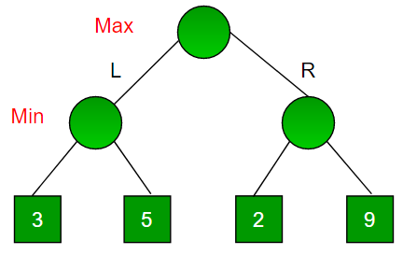
MINMAX Tree Example
Example:
A game has 4 final states
paths to reach final state are from root to 4 leaves of a perfect binary tree as shown below.
Assume
  you are the maximizing player
  you get the first chance to move
  i.e., you are at the root and your opponent at next level.
Which move you would make as a maximizing player considering that your opponent also plays optimally?

Slide 10
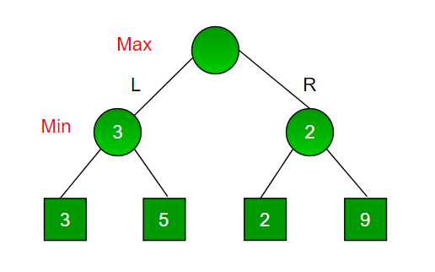
MINMAX Tree Example
It is a backtracking based algorithm, so it tries all possible moves, then backtracks and makes a decision.
  Maximizer goes LEFT
    It is now the minimizers turn.
    minimizer now has a choice between 3 and 5.
    Being the minimizer it will definitely choose the least among both, that is 3

Slide 11
It is a backtracking based algorithm, so it tries all possible moves, then backtracks and makes a decision.
  Maximizer goes RIGHT:
    It is now the minimizers turn.
    The minimizer now has a choice between 2 and 9.
    He will choose 2 as it is the least among the two values.

Slide 12
  As a maximizer you would choose the larger value that is 3.
    Hence the optimal move for the maximizer is to go LEFT and the optimal value is 3.
  As a maximizer you would choose the larger value that is 3.
    Hence the optimal move for the maximizer is to go LEFT and the optimal value is 3.
3

Slide 13
MINMAX for Tic Tac Toe

Slide 14

Game Tree (2-player, Deterministic, Turns)
computer’s
turn
opponent’s
turn
computer’s
turn
opponent’s
turn
leaf nodes
are evaluated
The computer is Max.
The opponent is Min.
At the leaf nodes, the
utility function
is employed. Big value
means good, small is bad.

Slide 15
Minimax Function
MINIMAX-VALUE(n) =
  UTILITY(n) if n is a terminal state
  max_{s} _{∈ Successors(n)} MINIMAX-VALUE(s) if n is a MAX node
  min_{s} _{∈ Successors(n)} MINIMAX-VALUE(s) if n is a MIN node
CS 484 – Artificial Intelligence
Notes:
minimax performs complete depth-first search of tree O(b^m) where max depth of tree = m and b legal moves at each point
for real games this time cost is totally impractical

Slide 16
Tic-Tac-Toe
X | O
e(p) = 6 - 5 = 1
Initial State: Board position of 3x3 matrix with 0 and X.
Operators: Putting 0’s or X’s in vacant positions alternatively
Terminal test: Which determines game is over
Utility function:
e(p) = (No. of complete rows, columns or diagonals are still open for player ) – (No. of complete rows, columns or diagonals are still open for opponent )

Slide 17
Minimax Algorithm
Generate the game tree
Apply the utility function to each terminal state to get its value
Use these values to determine the utility of the nodes one level higher up in the search tree
  From bottom to top
  For a max level, select the maximum value of its successors
  For a min level, select the minimum value of its successors
From root node select the move which leads to highest value

Slide 18
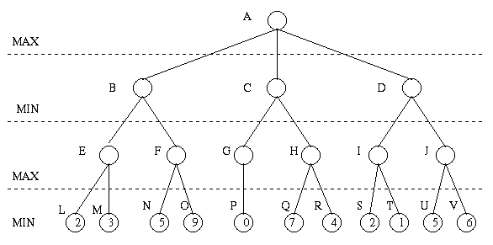
Minimax Algorithm (cont’d)
3
3
0
2
3
9
0
7
2
6
Payoff for Max

Slide 19



















































Key Idea: Look Ahead
Tic-tac-toe (or Noughts and crosses, Xs and Os)
We start 3 moves per player in:
3x3 Tic-Tac-Toe
optimal play
X’s turn
O’s turn
X
loss
loss

Slide 20




































Look-ahead based Tic-Tac-Toe
X’s turn
O’s turn
X
Tie
Tie
Tie
Tie

Slide 21




























Look-ahead based Tic-Tac-Toe
X’s turn
O’s turn
Win for O
Win for O
Tie
Tie
Tie
Tie

Slide 22
Look-ahead based Tic-Tac-Toe
X’s turn
O’s turn
Win for O
Win for O
Tie
Tie
Tie
Tie

Slide 23
Look-ahead based Tic-Tac-Toe
X’s turn
Win for O
Tie
Win for O
O’s turn
Win for O
Tie
Tie
Tie
Tie
Win for O

Slide 24
Each board in game tree gets unique
game tree value (utility; -1/0/+1)
under optimal rational play.
(Convince yourself.)
E.g. 0 for top board.
What if our opponent
does not play optimally?
X’s turn
Win for O
Tie
Win for O
Approach: Look first at bottom tree. Label bottom-most boards.
Then label boards one level up, according result of best possible move.
… and so on. Moving up layer by layer.
Termed the Minimax Algorithm
  Implemented as a depth-first search

Slide 25
Properties of Minimax
Complete : Yes (if tree is finite)
Time complexity : O(b^{d})
Space complexity : O(bd) (depth-first exploration)

Slide 26
Properties of minmax algorithm in AI
The algorithm is complete, meaning in a finite search tree, a solution will be certainly found.
It is optimal if both the players are playing optimally.
Due to Depth-First Search (DFS) for the game tree, the time complexity of the algorithm is O(bm), where b is the branching factor and m is the maximum depth of the tree.
Like DFS, the space complexity of this algorithm is O(bm).

Slide 27
Advantages
A thorough assessment of the search space is performed.
Decision making in AI is easily possible.
New and smart machines are developed with this algorithm.

Slide 28
Limitations
Because of the huge branching factor, the process of reaching the goal is slower.
Evaluation and search of all possible nodes and branches degrades the performance and efficiency of the engine.
Both the players have too many choices to decide from.
If there is a restriction of time and space, it is not possible to explore the entire tree.
But with Alpha-Beta Pruning, the algorithm can be improved.

Slide 29
Conclusion
This article explains all the aspects of the min-max algorithm in AI. First, an introduction of the theory is provided with examples of where it is used, after which there is a description of how the algorithm works in a game.
The algorithm is broken down to explain how a decision to make an optimal move is taken based on moves and counter moves of the players. The properties of the algorithm are then listed. Lastly, the advantages and disadvantages of the algorithm are provided.

Slide 30
Observation
Minimax algorithm, presented above, requires expanding the entire state-space.
Severe limitation, especially for problems with a large state-space.
Some nodes in the search can be proven to be irrelevant to the outcome of the search

